Slide 1


Edge Applications In Cloud Computing

Slide 2


Table Of Contents
Abstract
Introduction
Key Features
Comparison
Conclusion

Slide 3
Abstract
Edge Applications in Cloud it refers to services that are deployed closer to the customers or End users instead of using centralized server, It uses several protocols like green grass core , Device shadow to make secured connections to get control over the resources and operations in offline and make use of Sensors for Real world communication. It also uses Band-Width Efficiency, Scalability for avoiding the data loss and making scalable for more users. It also takes the Security measures like Attenuation, Authorization, End-End Encryption to make the server and the data safe. It contains Database in it to store the information and for backing up data in case of any failure. It operates on Distributed Processing to make server independent. It balances the issues like Low Latency, Load Balancing, Fault Tolerance to avoid failures in the process of communication.

Slide 4
Introduction
The "edge" in edge computing refers to the outer edges of the network, closer to where devices and users are located. This could be your smartphone, a smart device in your home, or a sensor on a machine.
Edge applications in cloud computing bring the cloud's capabilities closer to you, making things faster, more reliable, and often more private, while also allowing smart devices to make quick decisions on their own.
The content providers and application developers can use the Edge computing systems by offering the users services closer to them. Edge computing is characterized in terms of high , ultra-low latency, and real-time access to the network information that can be used by several applications

Slide 5
Key features
Device Shadow & Green grass core :"Device Shadow" and "AWS IoT Greengrass Core" are two components or concepts associated with Amazon Web Services (AWS) that play significant roles in managing and coordinating edge devices.
.Bandwidth: bandwidth plays a crucial role in ensuring the efficient and effective operation of various processes in terms of data transfer, real time communication, content delivery, cloud processing, remote control.
Latency: Latency is a critical factor in edge applications in cloud computing because it directly impacts the responsiveness and effectiveness of these applications. Some of the key edge applications are reduced delays bandwidth efficiency, emergency response and edge to edge communication.
Security: Security is the important factor while transferring data it also checks the various factors like attenuation, authorization, risks, end to end encryption to make the data safe.
De-centralized cloud computing : Decentralized cloud computing, which involves distributing cloud computing resources to multiple edge locations, plays a significant role in enhancing the performance and efficiency of edge applications.
Load Balancing : Load balancing is of paramount importance in edge applications in cloud computing for several key reasons like traffic, optimization of resource scalability, Enhanced Perfomance, improving redundancy and scalability.

Slide 6
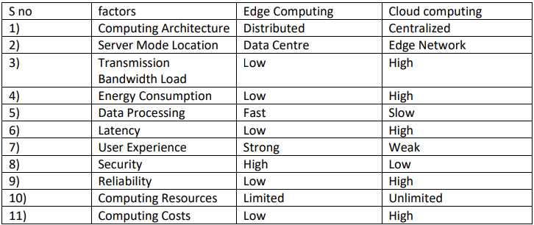
Comparison
Edge Computing vs Cloud Computing

Slide 7
Conclusion
Edge applications in cloud computing plays a vital role providing services to the end users. It helps in proper utilization of resources. Edge Applications are the Essential components in cloud computing in order to transfer or transmit the data it can handles various kinds of data. It helps in managing the data provides security with out the edge server we cannot be able to transfer the data which is of high cost . It works on distributed processing makes the server independent on the other servers this mainly helps in recovery of the data in this the data is transmitted fast. The resources are allocated and used accordingly on request basis of cloud computing .It provides higher the security.
It provides the various applications in some key areas like Health care, Smart cities, Transportation, Agriculture, Retail etc..

